Slide 1


CRAFTING & COMPELLING WEBSITE ANALYSIS, AUDIT AND RECOMMENDATIONS
GAYATHRI - MBE11 - GUVI

Slide 2


TASK – I
COMPANY SELECTION

Slide 3

INFOSYS Transforming Businesses Globally
Infosys is a global leader in next-generation digital services and consulting. With over 40 years of experience, the company partners with clients to navigate their digital transformation journey and unlock their business potential.

Slide 4

About Infosys
Global Presence
Innovative Solutions
Infosys has a global footprint, with a presence in 46 countries and serving clients across industries.
The company's portfolio includes a wide range of digital services and products, helping clients drive innovation.
Sustainability Focus
Talent Development
Infosys is committed to sustainable business practices and has been recognized for its environmental initiatives.
The company invests heavily in upskilling its workforce, ensuring they stay at the forefront of technology.

Slide 5
Infosys Products and Services
Consulting
Digital Services
Engineering Services
Infosys provides strategic consulting services to help clients navigate their digital transformation and achieve operational excellence.
The company offers a comprehensive suite of digital services, including cloud, data analytics, artificial intelligence, and automation.
Infosys leverages its engineering expertise to help clients develop innovative products and solutions.

Slide 6


TASK – II
PRODUCT AND SERVICE DESCRIPTIONS

Slide 7
PRODUCT AND SERVICE DESCRIPTIONS
Infosys Finacle
Infosys Topaz
Infosys Cortex
A comprehensive suite of banking and financial services solutions that help financial institutions drive digital transformation and achieve frictionless customer experiences.
A digital marketing platform that enables businesses to create personalized customer experiences and drive engagement through targeted campaigns.
A cloud-based platform that provides advanced analytics and AI-driven insights to help businesses make data-driven decisions and improve operational efficiency.
Infosys Wingspan
Infosys Meridian
A digital commerce platform that helps businesses create seamless omnichannel shopping experiences, driving customer loyalty and revenue growth.
A live enterprise workplace platform that supports remote work and collaboration, enabling organizations to create a productive and engaging work environment.

Slide 8

TASK – III
WEBSITE PLATFORM IDENTIFICATION

Slide 9
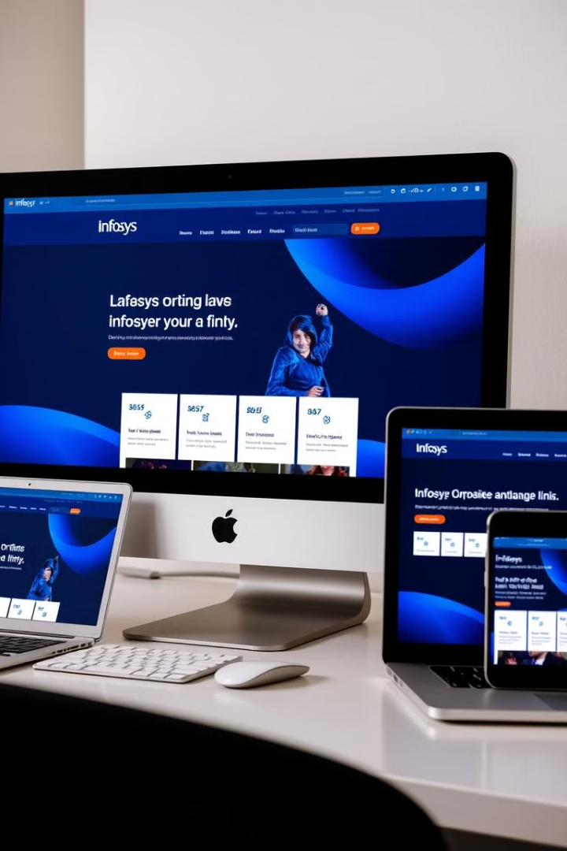
Infosys Website Platform
WordPress
Customization
The Infosys website is built on the WordPress content management system, a popular and flexible platform.
Infosys has heavily customized the WordPress platform to create a unique and engaging online presence.
Scalability
The website's WordPress foundation provides the scalability and flexibility to accommodate the company's growing needs.

Slide 10
Infosys Website Technology Stack
Tool used : BuiltWith

Slide 11
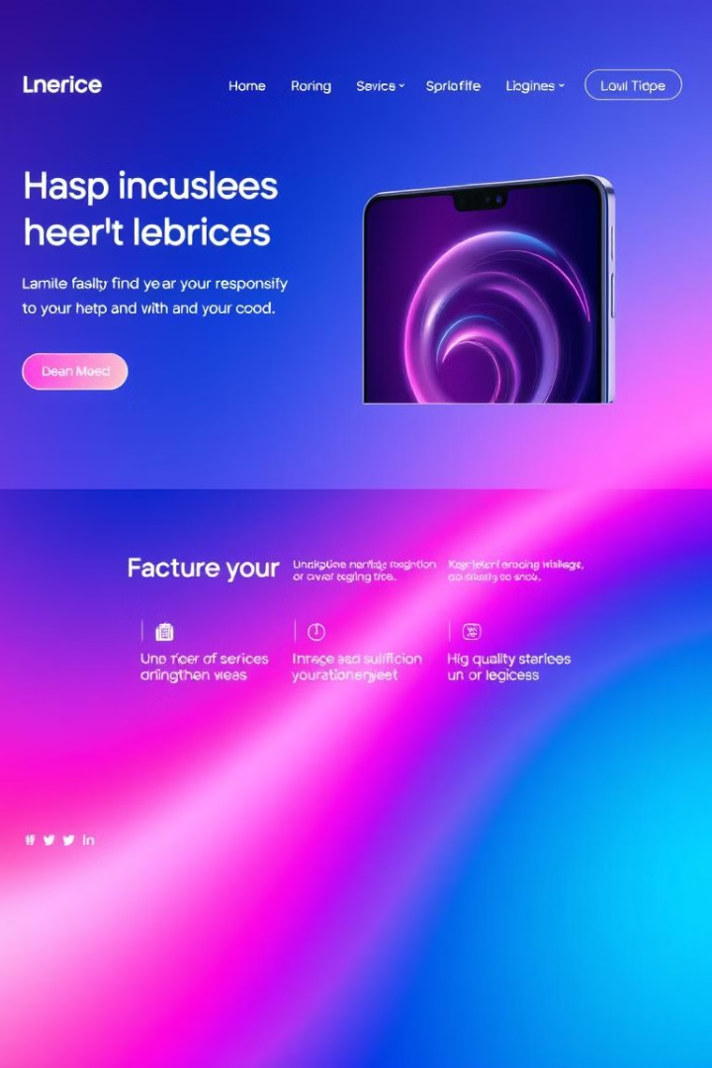
TASK – IV
RESPONSIVE DESIGN TESTING

Slide 12
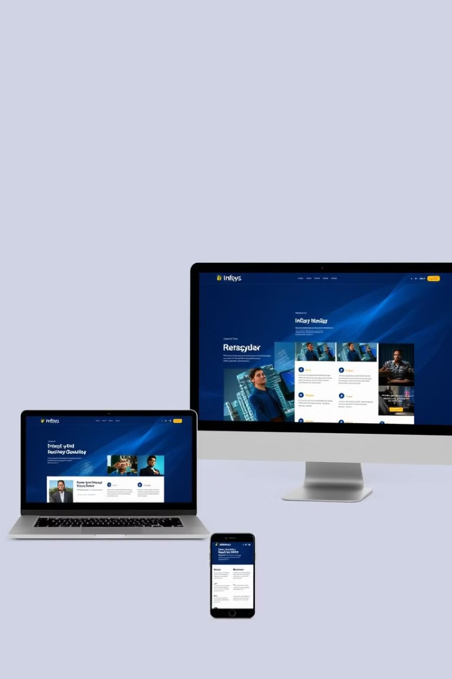
Device Wise Testing
1
Desktop
The website provides an optimal experience on larger screens, with a clean and organized layout.
2
Tablet
The website seamlessly adjusts to tablet devices, ensuring content and navigation are easily accessible.
3
Mobile
The website's responsive design adapts to smaller mobile screens, maintaining usability and aesthetics.

Slide 13

Tools Used
1
Google Mobile-Friendly Test
2
BrowserStack
Enables testing across multiple real devices to assess compatibility and responsiveness.
Quickly checks if a page meets mobile-friendly standards and provides optimization suggestions.
3
MobiReady
Provides detailed feedback on site performance and layout on high, mid, and low-tier mobile devices.

Slide 14
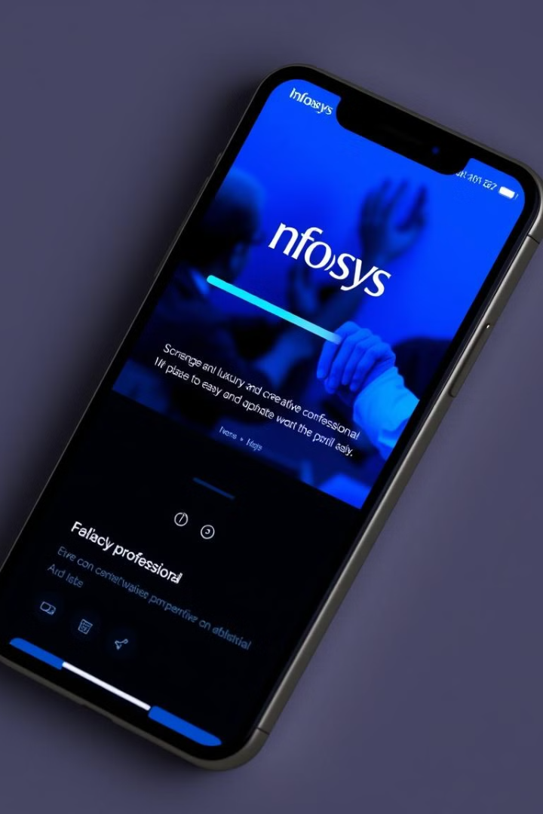
Homepage Analysis - URL
1
Responsiveness
2
Strengths
The homepage is mobile-friendly with a responsive layout that adjusts well to different screen sizes.
Text is legible without zooming. Navigation menus collapse into a hamburger menu for easy access. High-resolution images scale correctly.
3
Weaknesses
4
Recommendations
The page load speed on mobile is slightly slower than optimal due to large image files.
Some clickable elements (e.g., CTA buttons) are close together, which could lead to accidental clicks.
Optimize images using next-gen formats like WebP.
Increase spacing around clickable elements to enhance usability.

Slide 15

About Us Page Analysis - URL
Responsiveness
Strengths
The layout adapts well to mobile devices, with proper scaling of text and images.
Clean design with adequate padding. Easy-to-navigate sections with clear headings.
Weaknesses
Recommendations
Touch elements like links are small, potentially reducing usability on smaller screens.
Increase touch target size for links and buttons. Ensure all text fits within the viewport without horizontal scrolling.

Slide 16
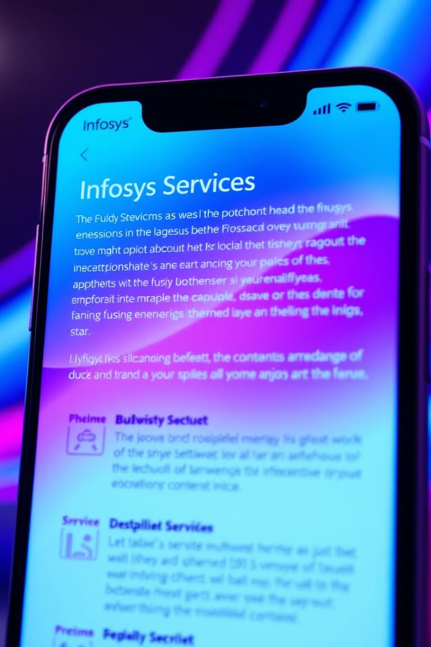




Services Page Analysis - URL
Responsiveness
The page is well-optimized for mobile devices, with a fluid grid layout.
Strengths
High readability of content with proper text hierarchy. Interactive elements like accordions for service details perform well.
Weaknesses
Some images take longer to load, impacting user experience.
Recommendations
Minimize render-blocking JavaScript to improve loading speed. Use lazy-loading techniques for below-the-fold images.

Slide 17
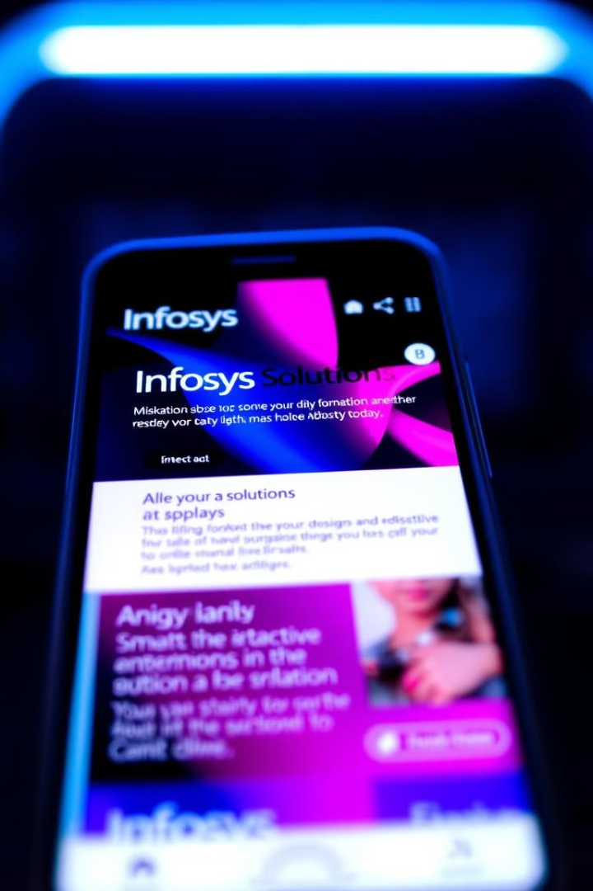
Solutions Page Analysis - URL
Responsiveness
The solutions page maintains its structure and interactivity on mobile screens.
Strengths
Interactive features like tabs and animations work seamlessly. Clear differentiation between sections with appropriate use of color.
Weaknesses
Long content sections may require better collapsible structures for mobile users.
Recommendations
Simplify navigation by introducing sticky headers for long sections. Optimize animations to ensure smooth transitions on mobile devices.

Slide 18





Contact Us Page Analysis - URL
Responsiveness
Strengths
Weaknesses
Recommendations
The contact form and map integrate well on smaller screens.
Forms are usable with no zooming required. Map integration is mobile-optimized.
Some alignment issues with form fields on smaller devices. The footer contains links that are closely packed.
Align form fields better to avoid overlap on very small screens. Improve spacing in the footer section for usability.

Slide 19

Summary of Findings
Common Recommendations
Mobile-Friendly Test
Image optimization and improved touch element sizing are common recommendations.
All five pages passed the Google Mobile-Friendly Test.
1
2
3
4
Layout and Navigation
Performance Enhancement
Navigation and layout adapt well across devices, but minor adjustments are needed for optimal usability.
Speed improvements through resource optimization (e.g., compressing images and minifying scripts) would enhance mobile performance.

Slide 20




Recommendations
Continuous Improvement
Regularly review and update the website to ensure it remains relevant and aligned with the company's evolving digital strategy.
Enhance User Experience
Continuously explore ways to improve the website's usability, navigation, and interactive features to enhance the customer journey.
Leverage Analytics
Utilize website analytics to gain insights into user behavior and preferences, informing future improvements and optimizations.

Slide 21
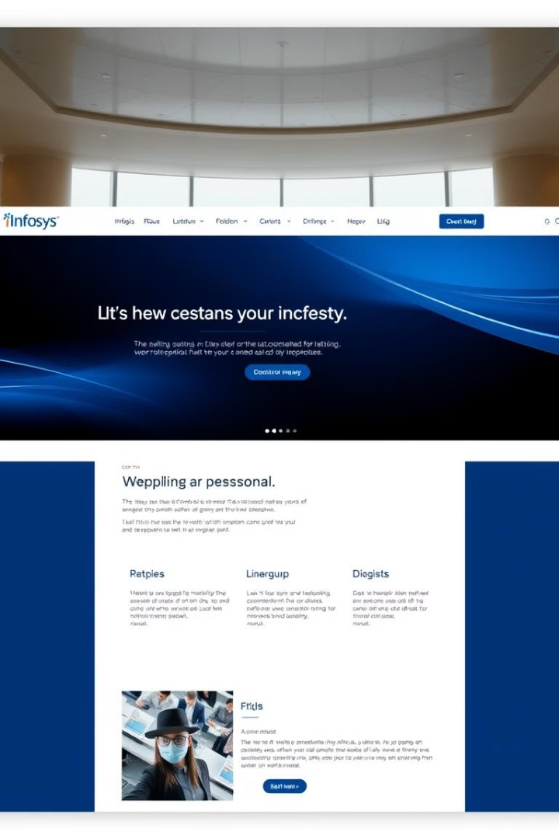
TASK – V
WEBSITE MISTAKES IDENTIFICATION

Slide 22
Common Design Pitfalls to Avoid
Accessibility Challenges
Slow Loading Times
Inconsistent Navigation Experience
Certain design elements, such as low-contrast text or non-descriptive alt attributes for images, may hinder accessibility for users with disabilities.
Some pages, particularly those with heavy graphics or animations, may experience slow loading, especially on mobile devices.
Navigation across pages sometimes lacks uniformity, which can be confusing for users transitioning between sections.
Mobile Responsiveness
Cluttered Layout
The website’s layout can appear overwhelming with dense information and multiple navigational options on some pages. This may cause cognitive overload for users.
While the website is responsive, some interactive elements are difficult to use on smaller screens, potentially affecting user engagement.

Slide 23
5 Improvement Suggestions for Infosys Website
Streamline Navigation
Enhance Visual Hierarchy
Mobile Responsiveness
Simplify the main navigation menu and group related sections together to make it easier for users to find the information they need.
Clearly prioritize the most important content and visual elements to guide the user's attention and create a more focused and engaging experience.
Refine touch targets for buttons and interactive features and test layouts thoroughly across various mobile devices to ensure usability.
Improve Accessibility
Optimize for Performance
Ensure the website adheres to WCAG guidelines, making it accessible to users with disabilities and enhancing the overall inclusivity of the platform.
Continuously monitor and optimize the website's technical performance, including load times, server response, and overall user experience metrics.

Slide 24
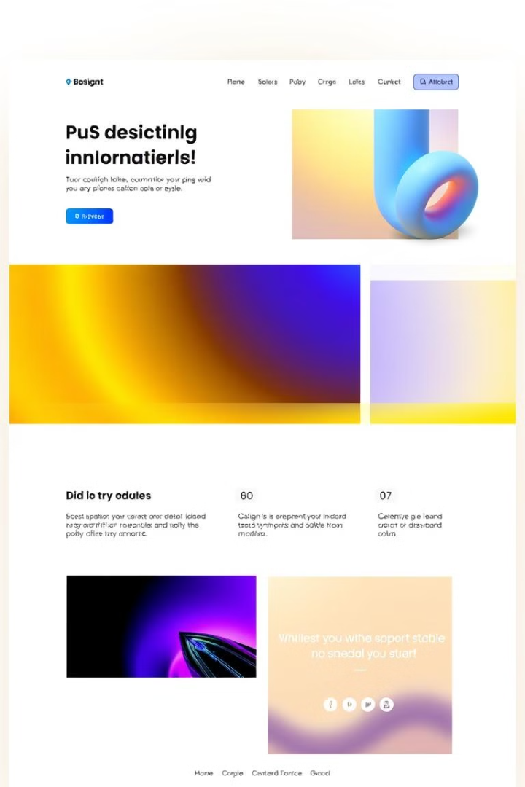
TASK – VI
BEST PRACTICES FOR VISUALLY APPEALING AND USER-FRIENDLY WEBSITE DESIGN

Slide 25

Understand User Needs and Preferences
1
User-Centric Design
2
Intuitive Navigation
Conduct user research and analyze their pain points, goals, and browsing habits to inform the design process.
Organize content and information architecture in a logical, easy-to-follow manner to enhance user experience.
3
Personalization
Tailor the website's content, layout, and interactions to cater to the specific needs and preferences of different user segments.

Slide 26
Implement Intuitive Navigation and Information Architecture
Intuitive Information Architecture
Clear Navigation
Logical Layout
Organize the website's structure and menu hierarchy to ensure users can easily find what they're looking for.
Group related content and features together, using visual cues and consistent patterns to guide users.
Develop a well-structured content hierarchy that aligns with user expectations and supports their decision-making process.

Slide 27

Leverage Consistent Branding and Visual Hierarchy
Cohesive Branding
Visual Hierarchy
Establish a strong and consistent visual identity that reinforces your brand's personality and values.
Use size, spacing, and other design elements to guide the user's attention and highlight the most important content.
Aesthetically Pleasing
Emotional Connection
Combine harmonious color schemes, engaging typography, and high-quality imagery to create an aesthetically appealing website.
Evoke positive emotions and a sense of trust through a visually captivating and coherent design.

Slide 28
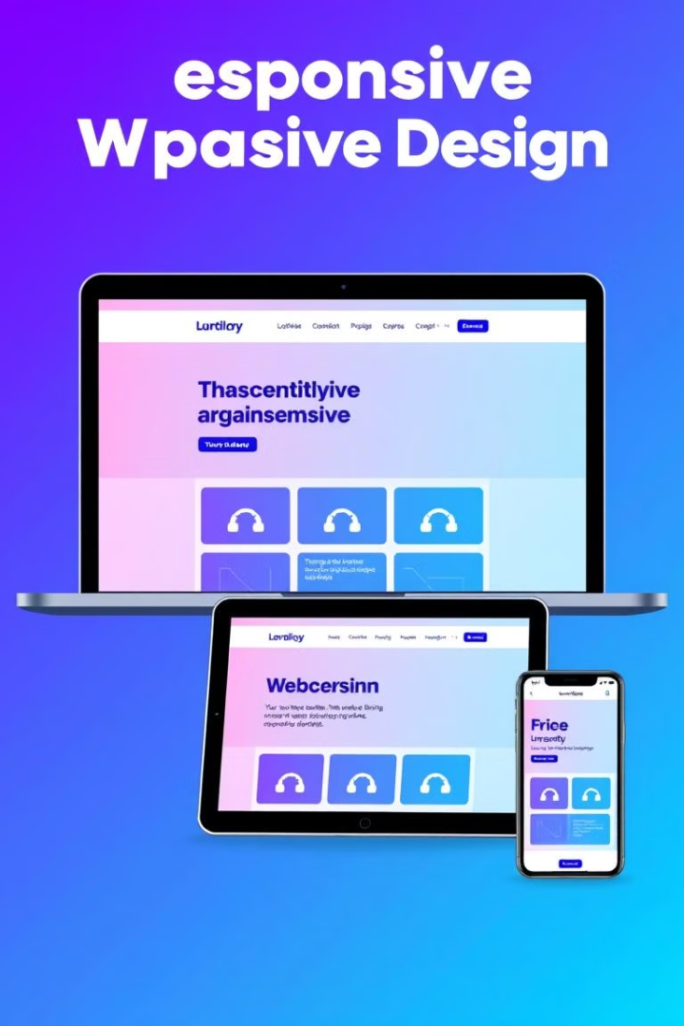




Optimize for Responsive Design and Accessibility
Mobile-Friendly
Accessibility
Ensure the website's layout and functionality are optimized for seamless user experiences across different devices and screen sizes.
Adhere to web accessibility guidelines to accommodate users with disabilities and ensure inclusive experiences.
Fast Load Times
Exceptional UX
Optimize website performance by minimizing file sizes, leveraging caching, and implementing other speed-enhancing techniques.
Prioritize user-centric design principles to create intuitive, engaging, and delightful experiences that keep users coming back.

Slide 29

TASK – VI
LANDING PAGE DESIGN

Slide 30
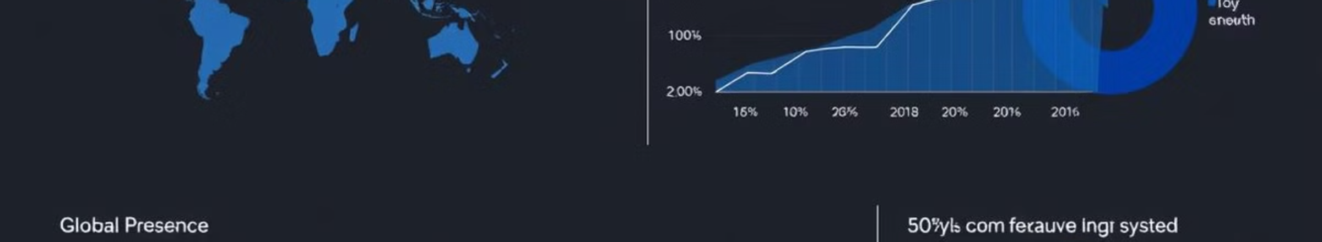
Objective
The primary objective of the landing page is to generate leads and increase brand awareness for Infosys' products or services.
Landing Page Design
Landing Page Design Link – Click here to view
Tool Used : WIX
Note : In a normal screen, the whole preview was opening correctly at 67% zoom.

Slide 31
Design Features
Design Features
Engaging Visuals
User-Friendly Layout:
Clear Headline: A compelling headline that communicates the key benefit of the product or service.
Subhead line: Additional details that support the headline and provide more information.
High-Quality Images and Videos: Use relevant and high-resolution images or videos that illustrate the product or service.
Brand Colors and Fonts: Maintain consistency with Infosys’ branding by using their color scheme and fonts.
Prominent CTA Button: Place a clear and compelling CTA button (e.g., "Request a Demo", "Contact Us") above the fold and throughout the page.
Action-Oriented Text: Use action verbs to encourage users to take the desired action.
Trust Elements
Persuasive Copy
Testimonials and Case Studies: Include customer testimonials, success stories, and case studies to build trust and credibility.
Client Logos: Showcase logos of well-known clients to reinforce trust and reputation.
Benefit-Focused Content: Highlight the benefits and features of the product or service.
Scannable Text: Use bullet points, short paragraphs, and headings to make the text easy to read and digest.

Slide 32
CONCLUSION

Slide 33




Conclusion and Key Takeaways
Comprehensive Audit
Innovative Thinking
User-Centric Approach
Regularly reviewing the website for potential design and usability issues is crucial for maintaining a top-notch online presence.
Embracing new design trends and technologies can help Infosys stay ahead of the curve and provide a unique user experience.
Focusing on the needs and preferences of the target audience should be the guiding principle for all website improvements.
By addressing the identified design issues and implementing the suggested improvements, the Infosys website can become a more intuitive, engaging, and high-performing platform that effectively supports the company's business objectives.

Slide 34
THANK YOU

